Slide 1
AP Studio Art Summer homework!!!!

Slide 2
You should be working on 4 assignments over the summer.
Self-Portrait
Landscape/city scape
Interior Space
Still Life

Slide 3
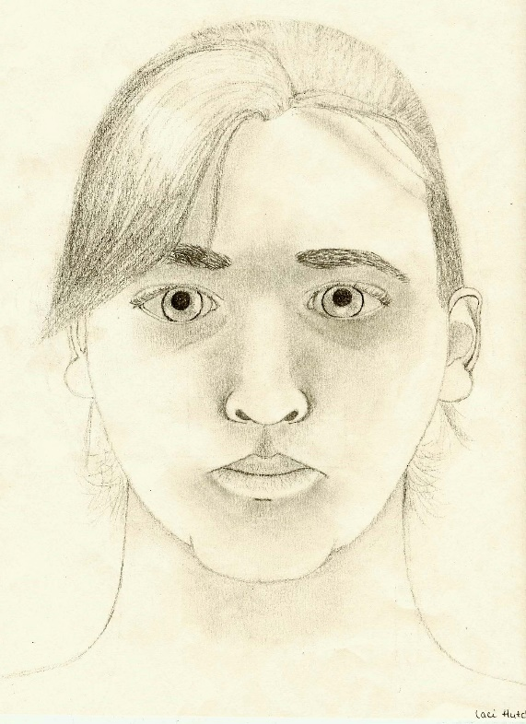
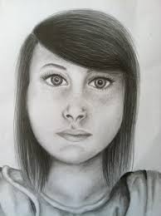
Self-Portrait
You have probably done many self portraits over the years and may be self-portraited out! So try to think outside the box with this one. It doesn’t have to be your run of the mill generic selfie!

Slide 4
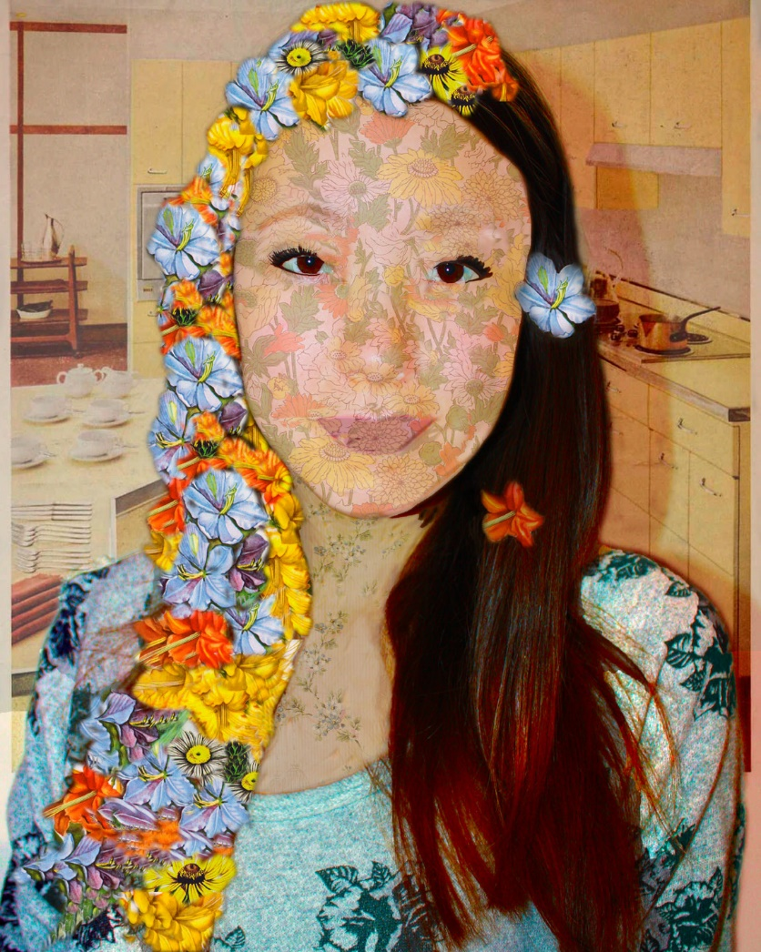
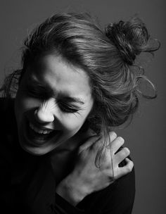
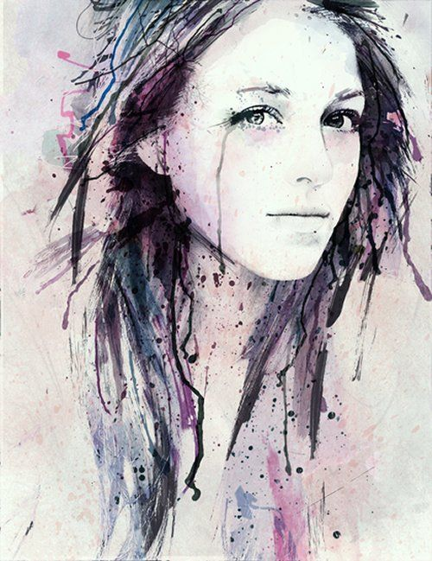
Look in a mirror…this is hard but good practice.
Think about an interesting pose/angle.
Draw a background!!! Even if it’s just shading and color.
Be creative!

Slide 5
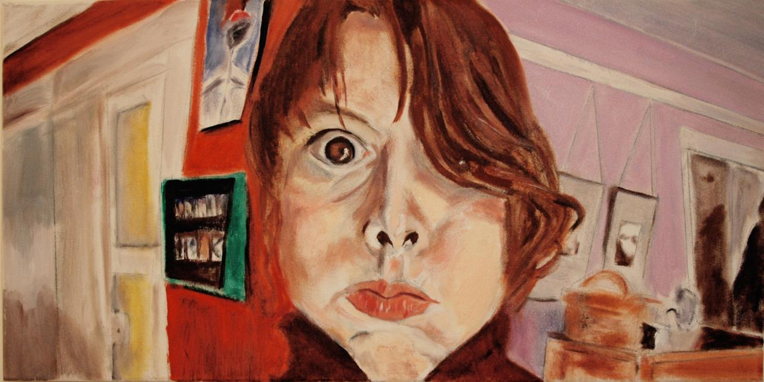

Slide 6
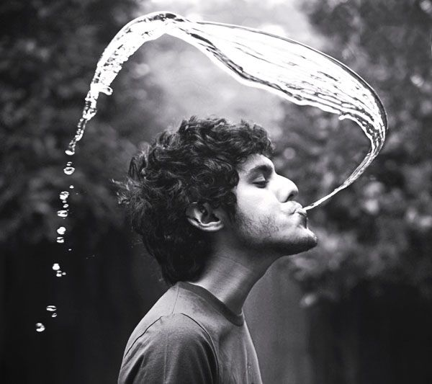
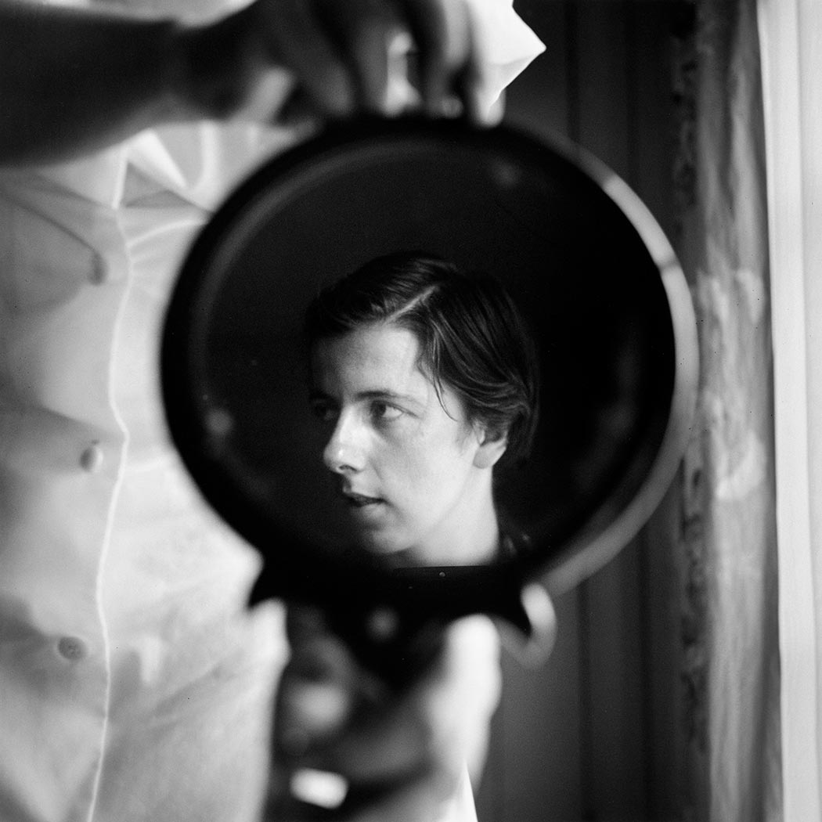
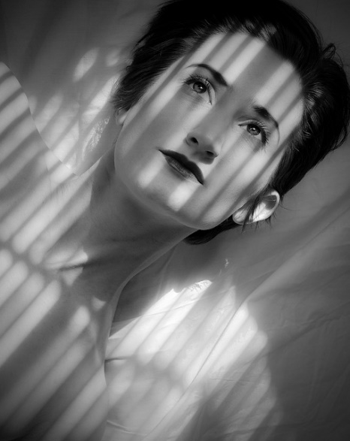
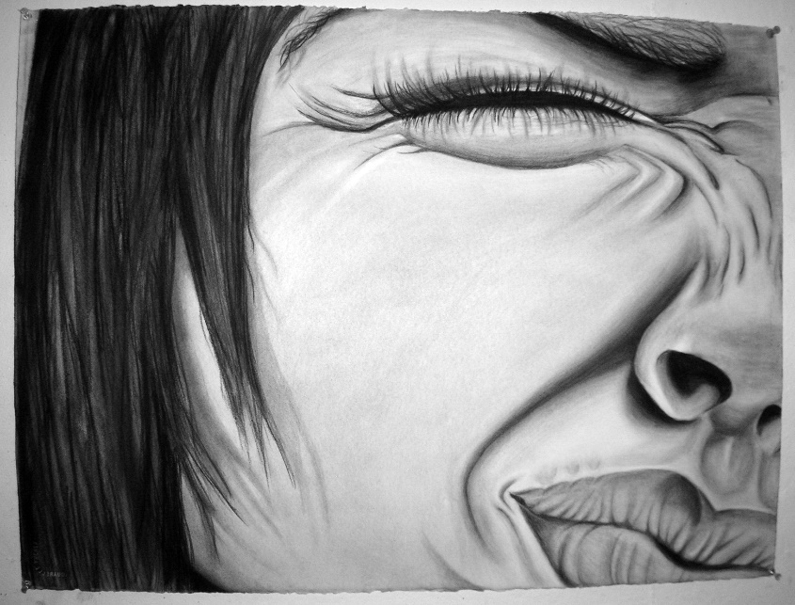
Think about light and shadow!!!!!!!

Slide 7
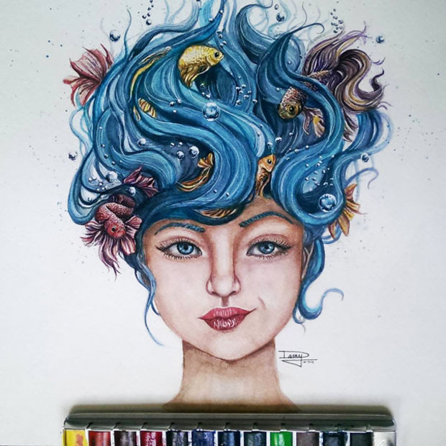
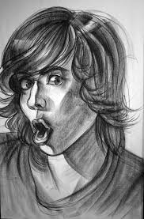
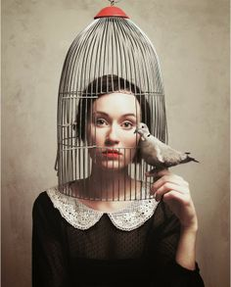
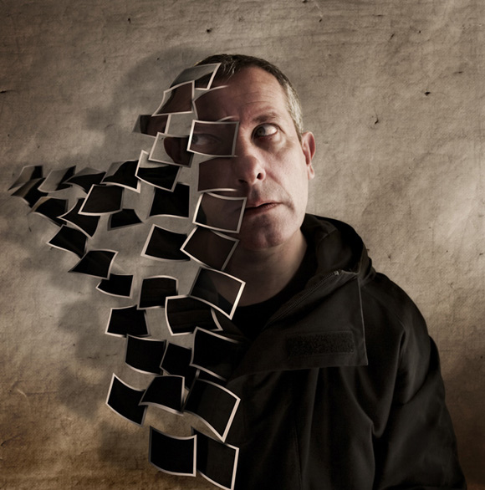
Be quirky!!!!!
If you are struggling for ideas
Google self-portraits!!!

Slide 8
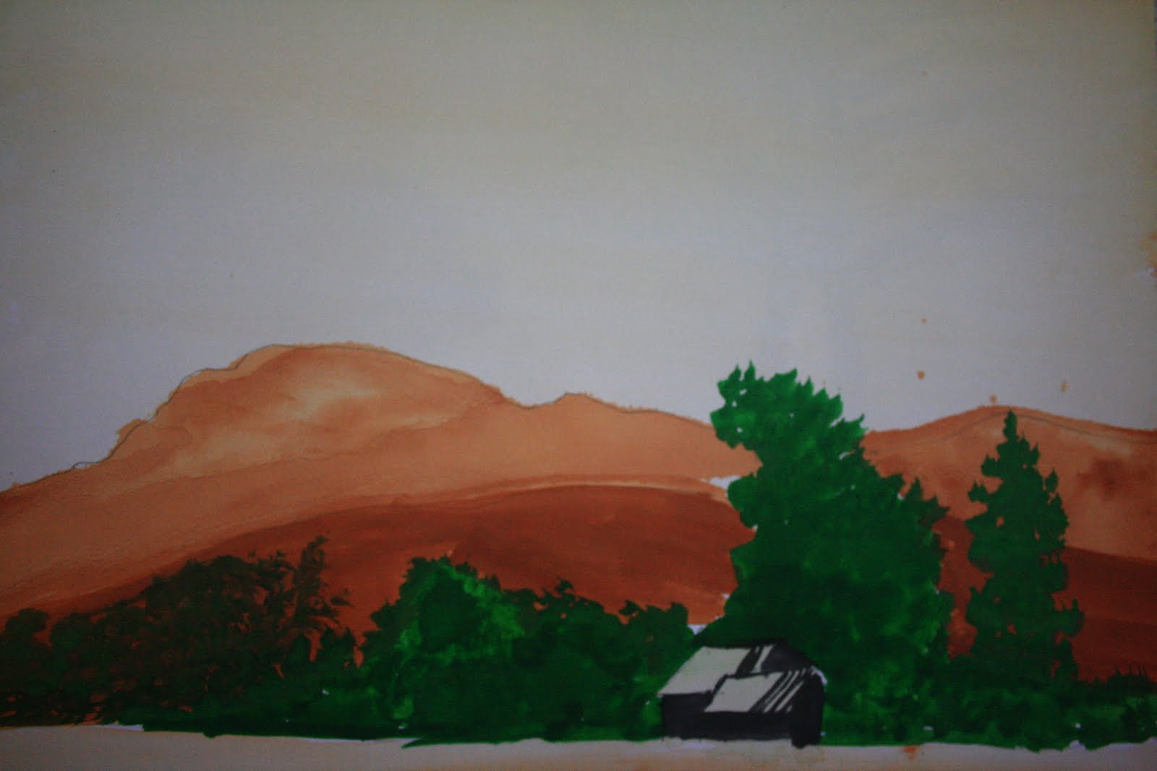
Land-scape/city-scape
Again…don’t just think about your run of the mill “boring” generic” land scape

Slide 9
This is an amazing photo!
But you don’t need to travel to amazing places to take interesting photos.

Slide 10
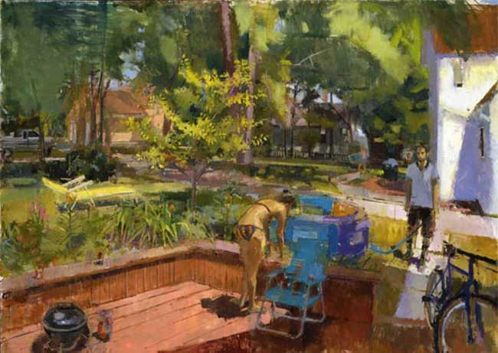
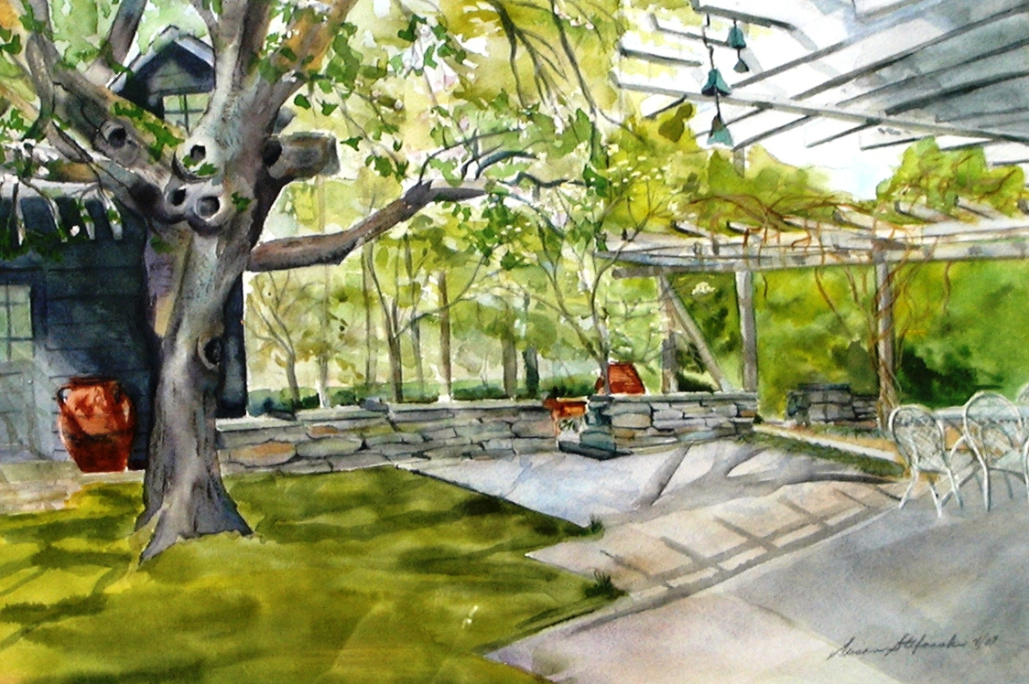
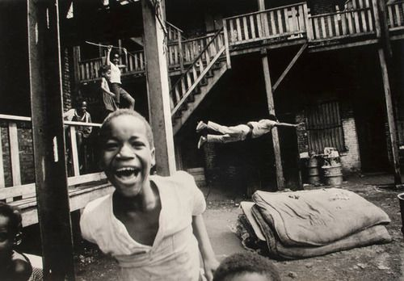
Sometimes just look in your own back yard!

Slide 11
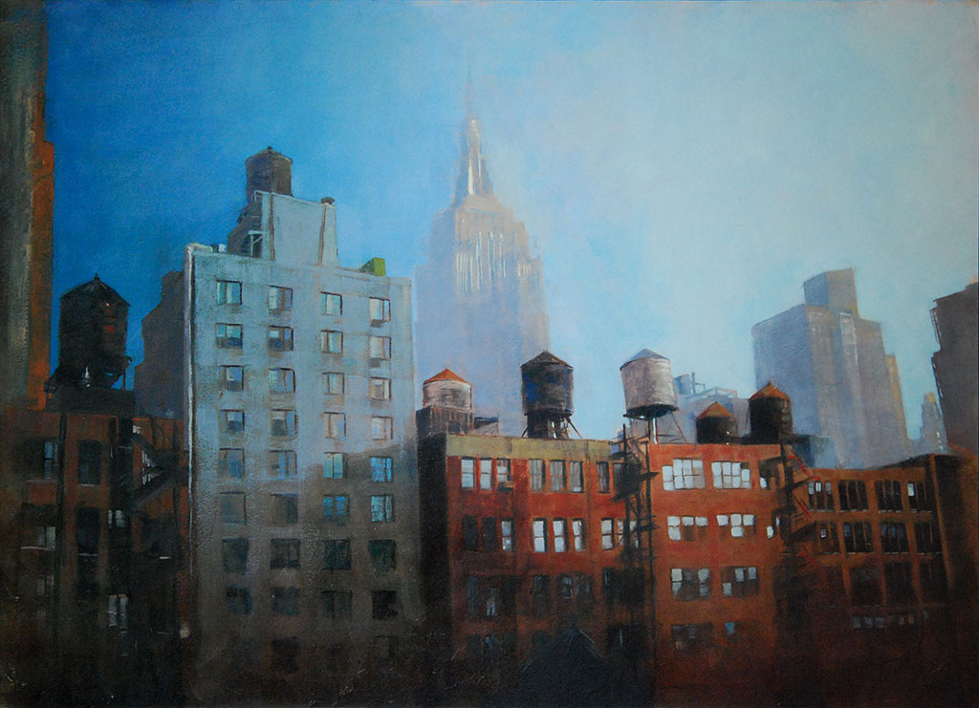
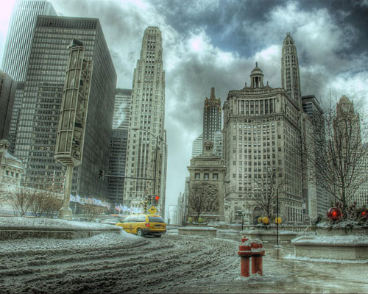
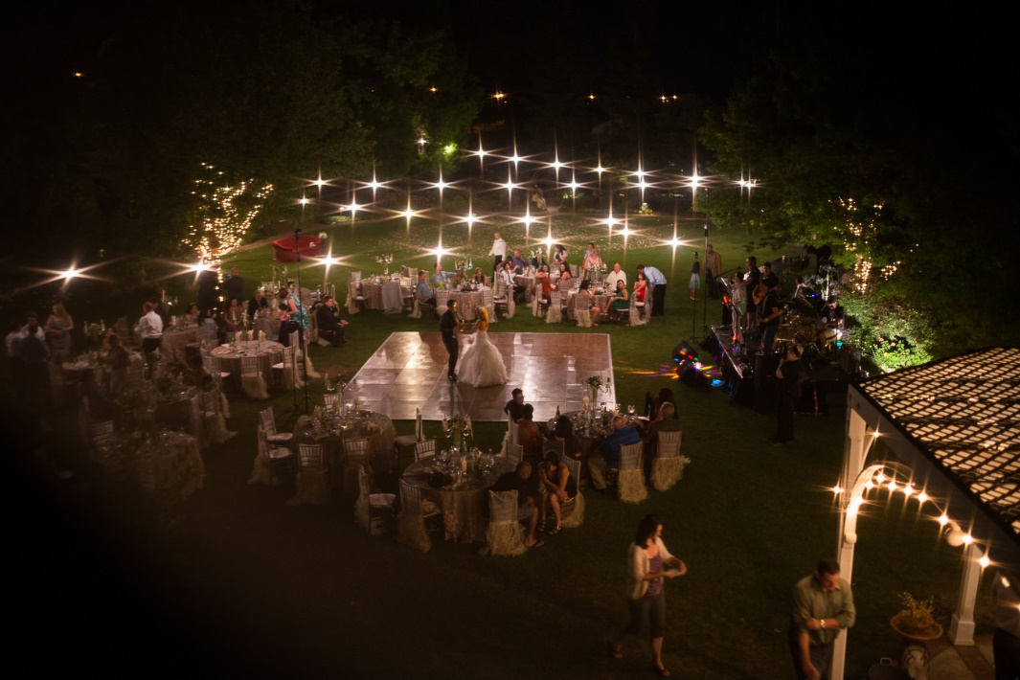
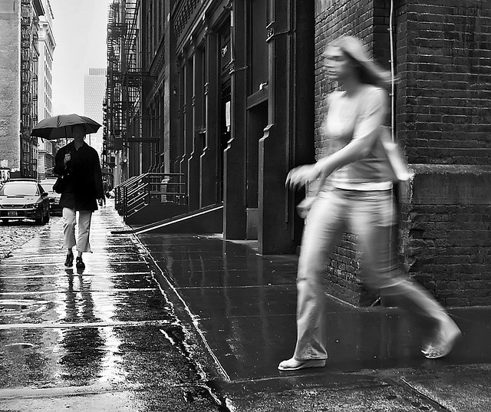

Slide 12
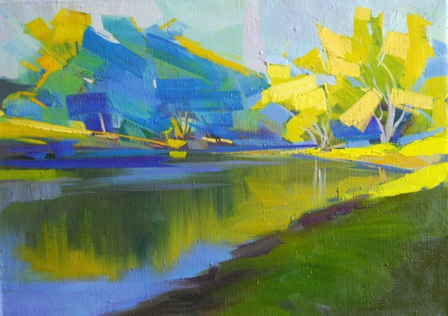
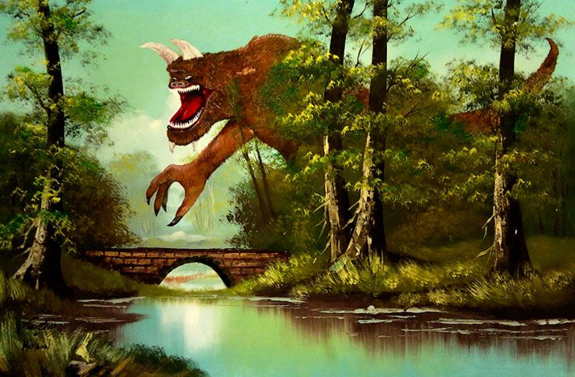
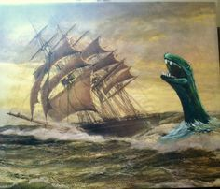
Again…Be quirky!!!

Slide 13
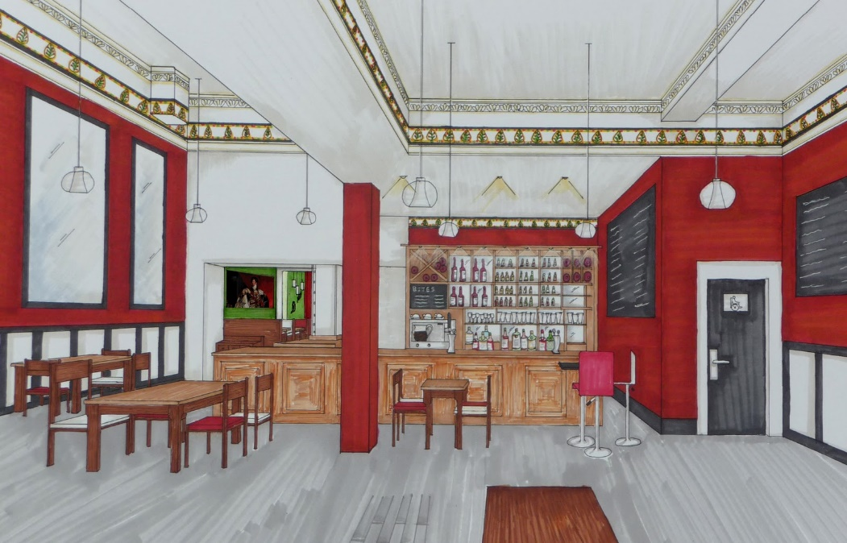
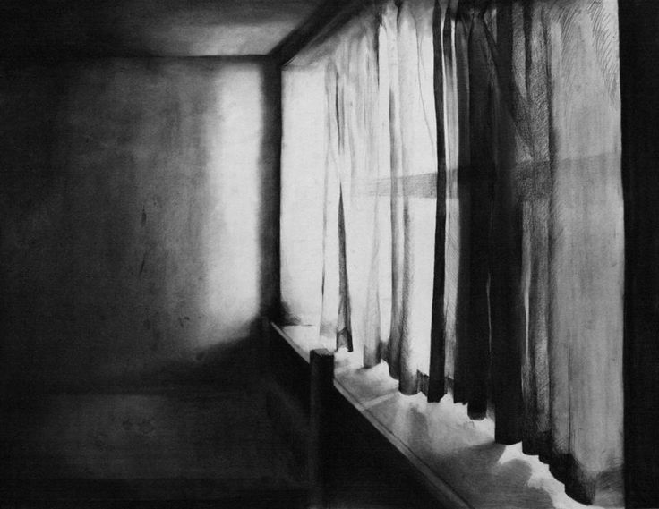
The interior space
This can be anything enclosed in an “interior”.

Slide 14
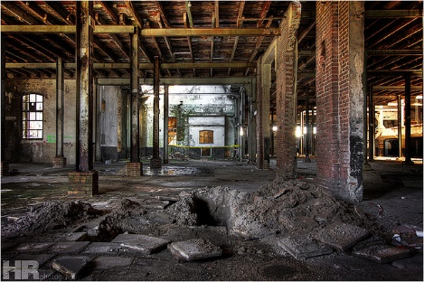
Abandoned places can make great interior works of art.

Slide 15
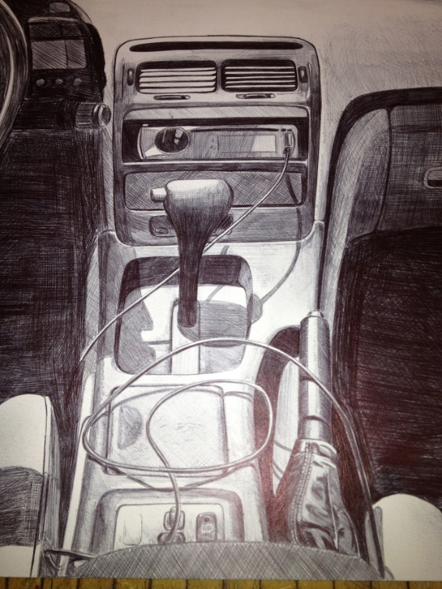
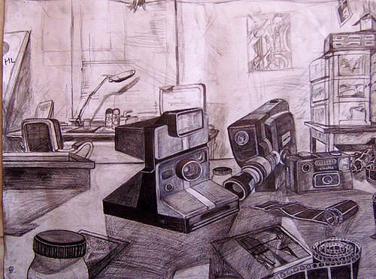
An Interior space can be “ANYTHING” within an enclosed space!

Slide 16
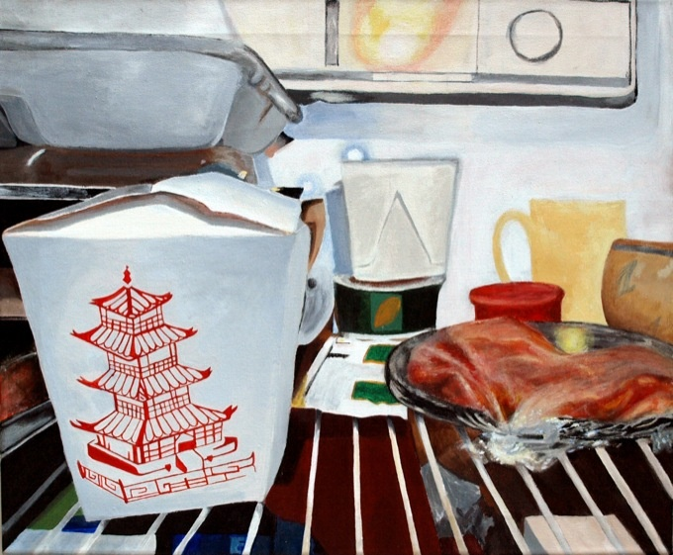
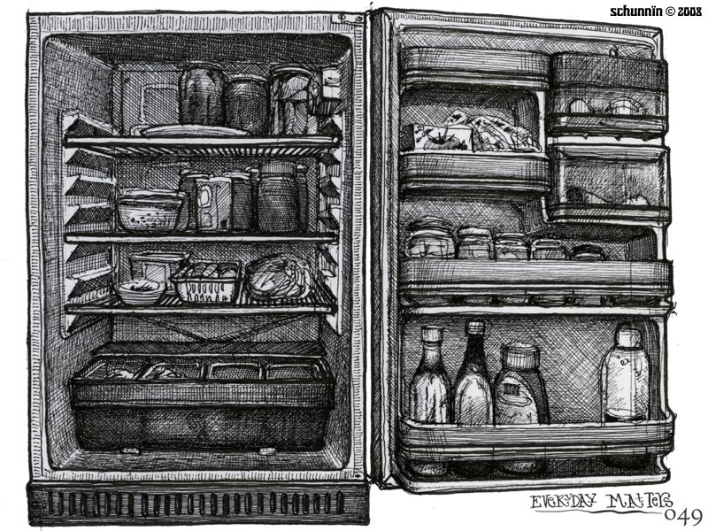
Refrigerators!!!!!!

Slide 17
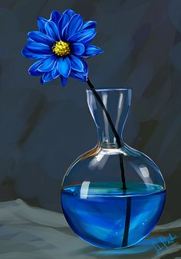
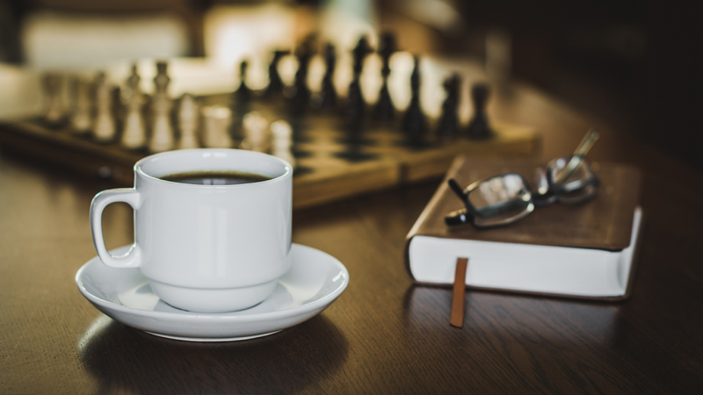
The still life
These are nicely done but…….
Take some chances!

Slide 18
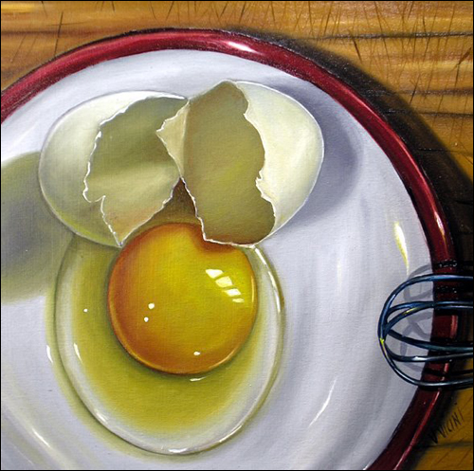
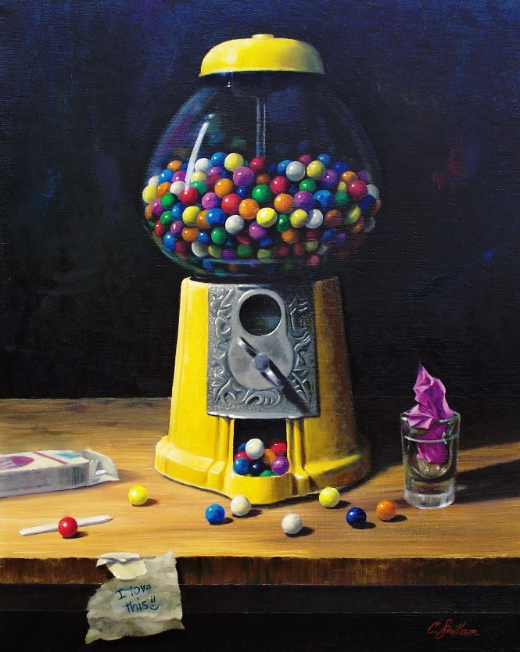
Try something like this!

Slide 19
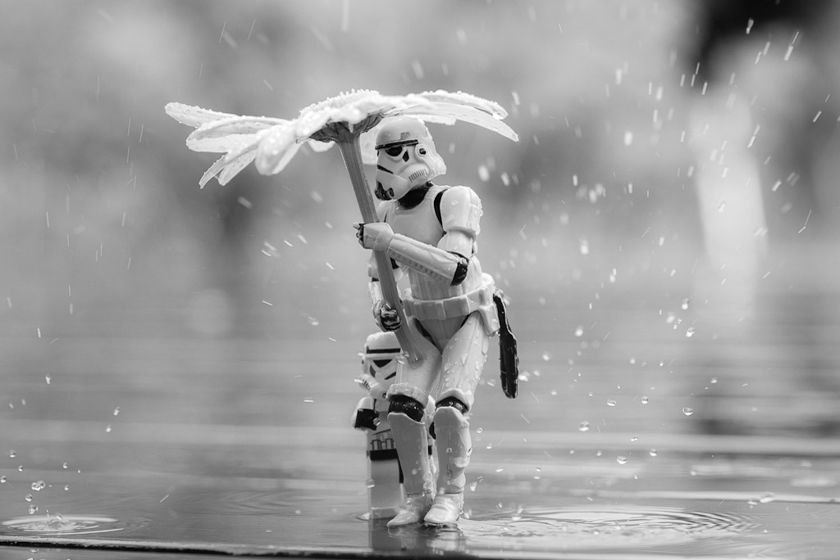
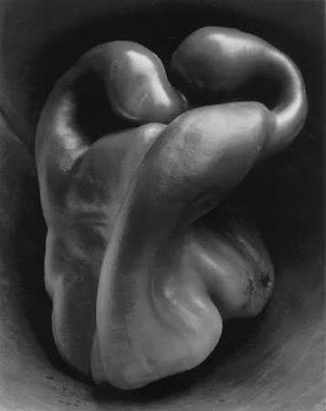
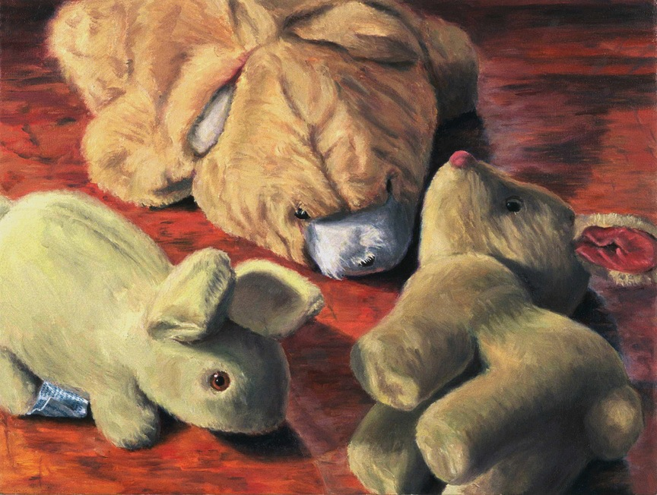
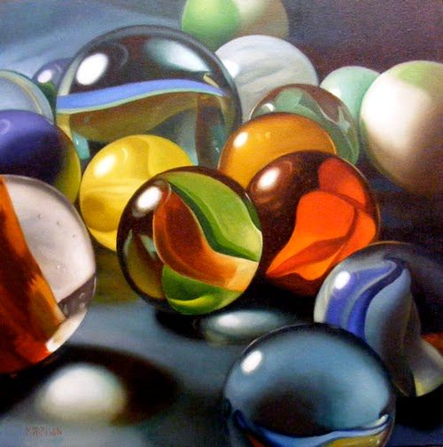

Slide 20
Use what ever mediums you want!
Be creative!
Have fun!
It will be to your advantage to get these 4 projects done over the summer. We will be looking at them during the first week of school.

